Slide 1
Machine Learning Instructor Dr. Syed Hamad Shirazi

Slide 2
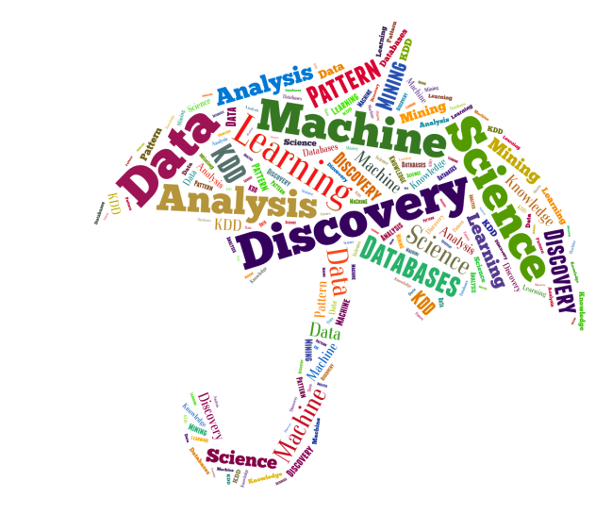
Current Trends
Machine Learning, Data Science, Data Mining, Data Analysis, Statistical Learning, Knowledge Discovery in Databases, Pattern Discovery.

Slide 3
Data everywhere!
1. Google: processes 24 peta bytes of data per day. 2. Facebook: 10 million photos uploaded every hour. 3. Youtube: 1 hour of video uploaded every second. 4. Twitter: 400 million tweets per day. 5. Astronomy: Satellite data is in hundreds of PB.
“By 2020 the digital universe will reach 44 zettabytes..."

Slide 4
Data Types
Data comes in different sizes and also flavors (types):
Texts
Numbers
Clickstreams
Graphs
Tables
Images
Transactions
Videos
Some or all of the above!
So We are Datafied

Slide 5
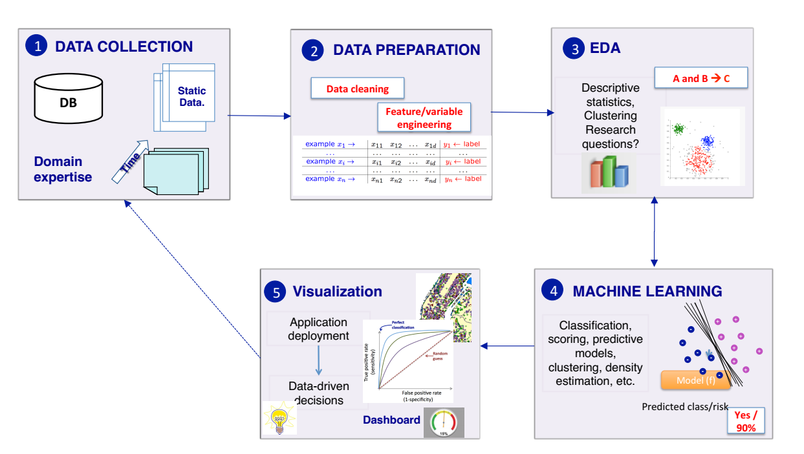
The Data Science process

Slide 6
Machine Learning
• Spam filtering • Credit card fraud detection • Digit recognition on checks, zip codes • Detecting faces in images • MRI image analysis • Recommendation system • Search engines
• Handwriting recognition • Scene classification

Slide 7
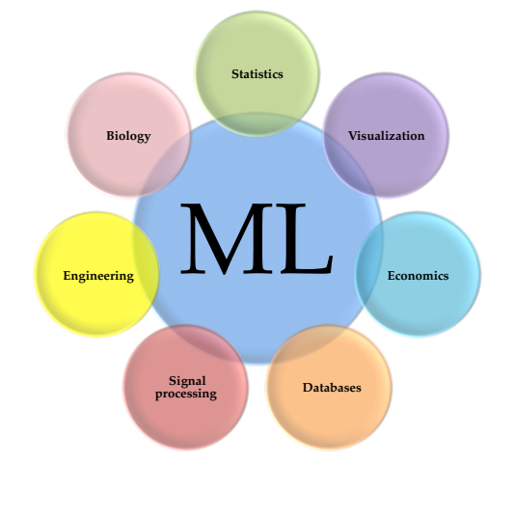
Interdisciplinary Field

Slide 8
Definition of Machine Learning
How do we create computer programs that improve with experience?
A computer program is said to learn from experience E with respect to some class of tasks T and performance measure P, if its performance at tasks in T, as measured by P, improves with experience E. " Tom Mitchell. Machine Learning

Slide 9
Machine Learning!
Machine learning is a discipline that deals with programming the systems so as to make them automatically learn and improve with experience.
Here, learning implies recognizing and understanding the input data and taking informed decisions based on the supplied data.
It is very difficult to consider all the decisions based on all possible inputs.
To solve this problem, algorithms are developed that build knowledge from a specific data and past experience by applying the principles of statistical science, probability, logic, mathematical optimization, reinforcement learning, and control theory.
Notes:
ML is an automated learning with little or no human intervention

Slide 10
Concepts of Learning
Learning is the process of converting experience into expertise or knowledge.
Learning can be broadly classified into three categories, as mentioned below, based on the nature of the learning data and interaction between the learner and the environment.
Supervised Learning
Unsupervised Learning
Semi-supervised Learning

Slide 11
Machine Learning Algorithms
Supervised learning algorithm
Unsupervised learning algorithm
Semi-supervised learning algorithm
Reinforcement learning algorithm

Slide 12
Supervised Learning
Supervised learning is commonly used in real world applications, such as face and speech recognition, products or movie recommendations, and sales forecasting. Supervised learning can be further classified into two types - Regression and Classification.
Regression trains on and predicts a continuous-valued response, for example predicting real estate prices.
Classification attempts to find the appropriate class label, such as analyzing positive/negative sentiment, male and female persons, benign and malignant tumors, secure and unsecure loans etc.

Slide 13
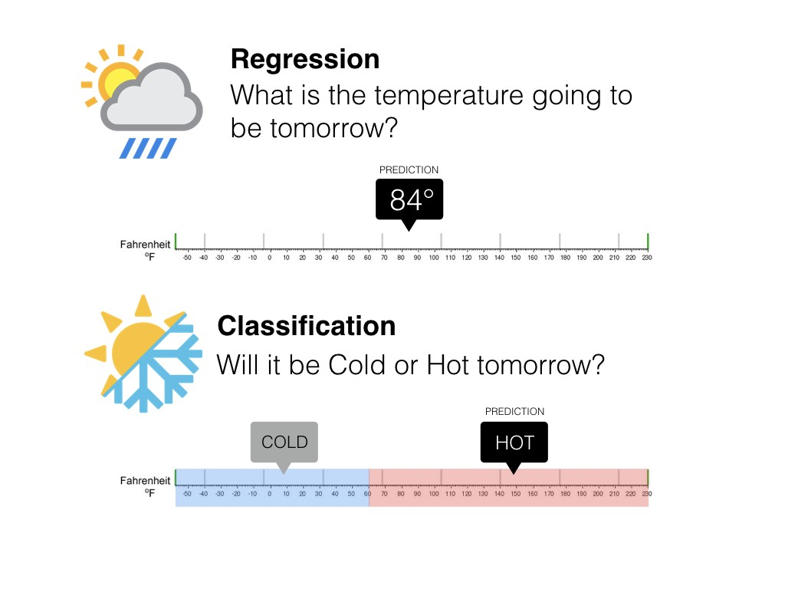
Regression Vs Classification

Slide 14
Supervised learning cont…..
Supervised learning deals with learning a function from available training data. Here, a learning algorithm analyzes the training data and produces a derived function that can be used for mapping new examples. There are many supervised learning algorithms such as Logistic Regression, Neural networks, Support Vector Machines (SVMs), and Naive Bayes classifiers.
Common examples of supervised learning include classifying e-mails into spam and not-spam categories, labeling webpages based on their content, and voice recognition.

Slide 15
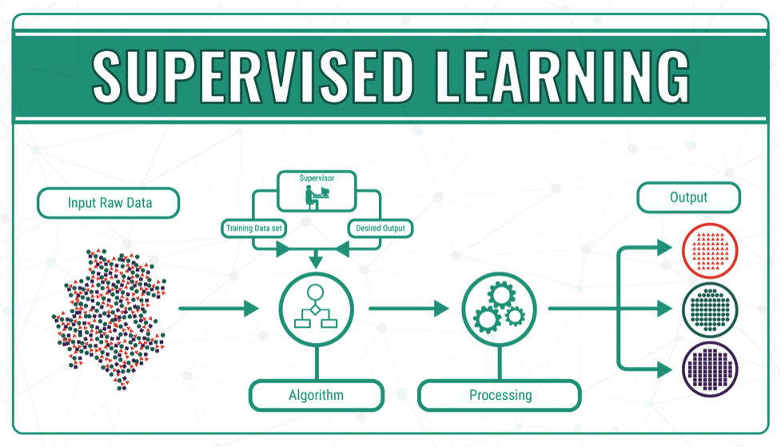
Supervised learning cont…..

Slide 16
Unsupervised Learning
Unsupervised learning is used to detect anomalies, outliers, such as fraud or defective equipment, or to group customers with similar behaviors for a sales campaign. It is the opposite of supervised learning. There is no labeled data here.
When learning data contains only some indications without any description or labels, it is up to the coder or to the algorithm to find the structure of the underlying data, to discover hidden patterns, or to determine how to describe the data. This kind of learning data is called unlabeled data

Slide 17
Unsupervised Learning cont…
Unsupervised learning algorithms are extremely powerful tools for analyzing data and for identifying patterns and trends. They are most commonly used for clustering similar input into logical groups. Unsupervised learning algorithms include Kmeans, Random Forests, Hierarchical clustering and so on.

Slide 18
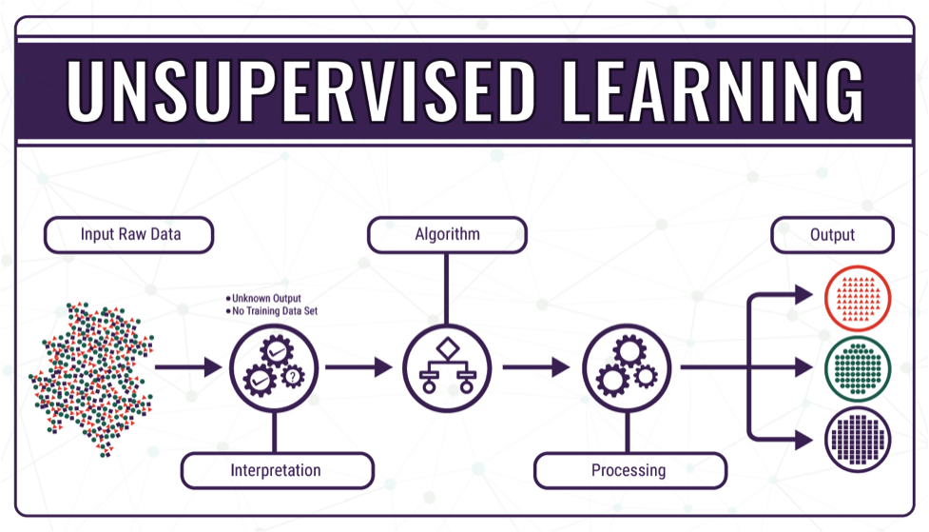
Unsupervised Learning cont….

Slide 19
Semi-supervised Learning
If some learning samples are labeled, but some other are not labeled, then it is semi-supervised learning. It makes use of a large amount of unlabeled data for training and a small amount of labeled data for testing. Semi-supervised learning is applied in cases where it is expensive to acquire a fully labeled dataset while more practical to label a small subset. For example, it often requires skilled experts to label certain remote sensing images, and lots of field experiments to locate oil at a particular location, while acquiring unlabeled data is relatively easy.

Slide 20
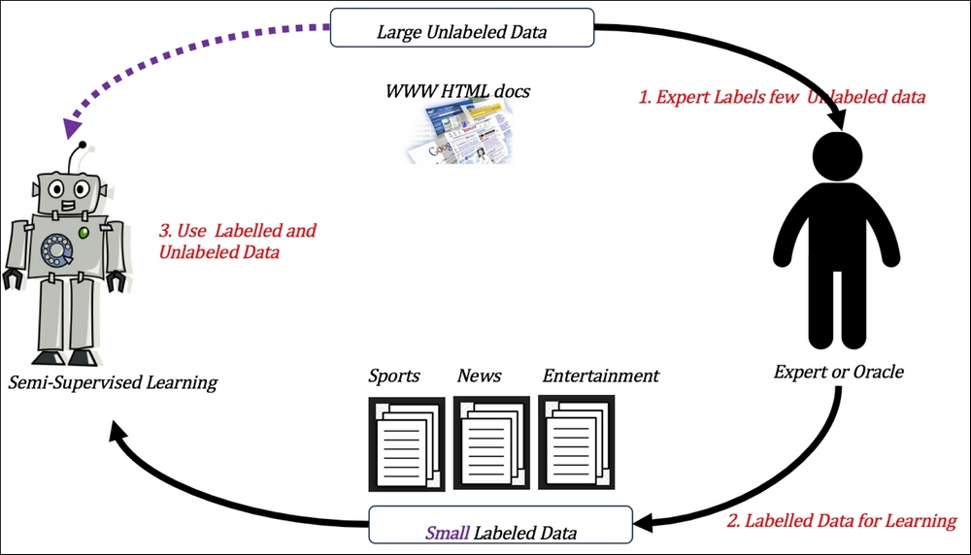
Semi-Supervised Learning

Slide 21
Reinforcement Learning
Here learning data gives feedback so that the system adjusts to dynamic conditions in order to achieve a certain objective. The system evaluates its performance based on the feedback responses and reacts accordingly. The best known instances include self-driving cars and chess master algorithm AlphaGo.

Slide 22
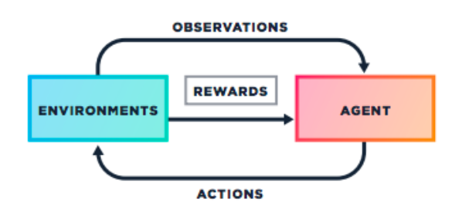
Reinforcement Learning cont…

Slide 23
Learning Problem!
A handwriting recognition learning problem: 1. Task T: recognizing and classifying handwritten words within images 2.Performance measure P: percent of words correctly classified
3. Training experience E: a database of handwritten words with given
classifications A robot driving learning problem: 1.Task T: driving on public four-lane highways using vision sensors 2. Performance measure P: average distance traveled before an error (as judged by human overseer) 3.Training experience E: a sequence of images and steering commands recorded while observing a human driver

Slide 24
How to Design Learning System
Choosing the training Experience
Choose what is exactly to be learned i.e. Target Function
Choose how to represent the target function
Choose the learning algorithm that infer the target function from experience

Slide 25
Concept Learning
A concept is a subset of objects or events defined over a larger set
Example: The concept of bird is the subset of all objects (i.e. the set of all things or all animals) that belong to the category of bird.
Technically Concept is a Boolean-valued function defined over this larger set.
Example A function defined over all animals whose value is true for birds and false for every other animals

Slide 26
Concept Learning Cont….
Concept learning. Inferring a Boolean-valued function from training examples of its input and output.
It is a some kind of notion that defines an object
It acquire an ability to define that whether that object belongs to a particular category or not.
Concept Data Object Label
x belong to concept C (1, true, +ve)
not belong to concept C (0, false, -ve)

Slide 27
Concept Learning Cont….
Attribute | Value
Shape | Oval, Circular
Size | Large, Small
Color | Dark, Light
Surface | Smooth, Irregular
h= , , , ,
H= all possible combinations
In this case we have 2 values for each
Attribute i.e 2¹⁶
^{e.g.} How many ways you can color 2 balls
Inductive Bias
Concept Space

Slide 28
Concept Learning cont….
Concept learning acquire an ability to define that whether an object belong to a concept or not.
indicate by a "?' that any value is acceptable for this attribute,
specify a single required value (e.g., circular) for the attribute, or
Ө indicate by a "0" that no value is acceptable.

Slide 29
Conjunctive Concept
It is the subset of all possible features you have in H
<Ө, Ө, Ө, Ө>
<circular, large, dark>
<oval, small, light>
<circular, small, dark, smooth>
<?,?,?,?>
How many Conjunctive concepts are there ?
C=(3x3x3x3)+1

Slide 30
Concept Learning Example
Instances X: Possible days, each described by the attributes
Sky (with possible values Sunny, Cloudy, and Rainy),
AirTemp (with values Warm and Cold),
Humidity (with values Normal and High),
Wind (with values Strong and Weak),
Water (with values Warm and Cool),
Forecast (with values Same and Change).

Slide 31
Example of Concept Learning
Example | Sky | Air-Temp | Humidity | Wind | Water | Forecast | Enjoy
1 | Sunny | Warm | Normal | Strong | Warm | Same | Yes
2 | Sunny | Warm | High | Strong | Warm | Same | Yes
3 | Rainy | Cold | High | Strong | Warm | Change | NO
4 | Sunny | Warm | High | Strong | Cool | change | Yes
If some instance x satisfies all the constraints of hypothesis h, then h classifies x as a positive example (h(x) = 1) other wise (h(x) = 0)

Slide 32
Total number of distinct hypothesis is
X=(3*2*2*2*2*2)=96 (Instances)
H=(4*3*3*3*3*3)+1=973 (Hypothesis)

Slide 33
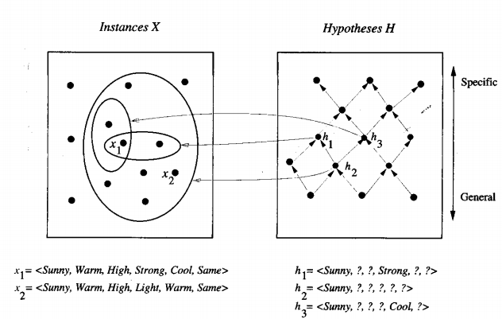
Moving from specific to General

Slide 34
Find S Algorithm
1. Initialize h to the most specific hypothesis in H 2. For each positive training instance x For each attribute constraint a, in h If the constraint a, is satisfied by x Then do nothing Else replace a, in h by the next more general constraint that is satisfied by x 3. Output hypothesis h

Slide 35
Version Space
It is an intermediate between the most specific ad most general hypothesis
It is the set of all hypothesis consistent with training data.
The version space will change as we change the dataset
Usually it derive multiple consistent hypothesis
In perfect case the case version space will derive a single hypothesis
In this case the target concept always consistent with the version space

Slide 36
List then Eliminate algorithm
The LIST-THEN-ELIMINATE Algorithm 1. VersionSpace c a list containing every hypothesis in H 2. For each training example, ( x ,c(x)) remove from VersionSpace any hypothesis h for which h(x) # c ( x ) 3. Output the list of hypotheses in VersionSpace

Slide 37
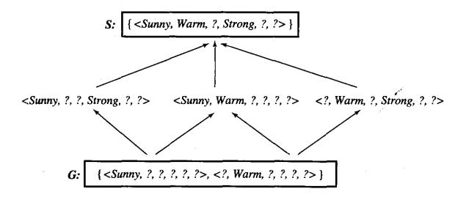
Version Space

Slide 38
Candidate Elimination Algorithm
It uses version spaces
It considers all the positive and negative examples
So we have both the general and specific hypothesis
For positive examples it generalize the hypothesis
For negative example we tend to move from general to specific

Slide 39
Candidate Elimination Algorithm
Initialize your most Specific S and most general G hypothesis
for each example e:
if e is positive
Make specific hypothesis more general
else
Make general hypothesis more specific

Slide 40
Decision Tree Learning
Decision Tree algorithm belongs to the family of supervised learning algorithms. Unlike other supervised learning algorithms, decision tree algorithm can be used for solving regression and classification problems too.
The general motive of using Decision Tree is to create a training model which can use to predict class or value of target variables by learning decision rules inferred from prior data(training data).

Slide 41
Decision Tree Algorithm
1. Place the best attribute of the dataset at the root of the tree.
2. Split the training set into subsets. Subsets should be made in such a way that each subset contains data with the same value for an attribute.
3. Repeat step 1 and step 2 on each subset until you find leaf nodes in all the branches of the tree.

Slide 42


Slide 43
Decision Tree…..
In decision trees, for predicting a class label for a record we start from the root of the tree. We compare the values of the root attribute with record’s attribute. On the basis of comparison, we follow the branch corresponding to that value and jump to the next node.

Slide 44
Decision Tree
Decision Tree represent a function that takes input vector of attributes and returns a decision “ Single output value”
The input output values can be continuous or discrete
Decision tree performs a sequence of tests to derive a decision.
Different Decision Tree Algorithms are:
ID3 (Iterative Dichotomiser 3)
C4.5 (Successor of ID3)
CART (Classification and Regression)

Slide 45
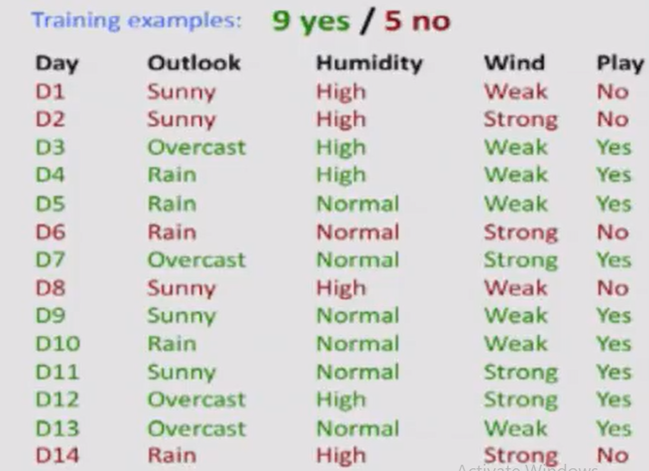
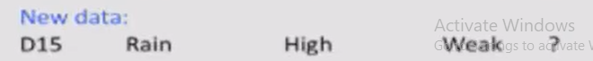

Slide 46
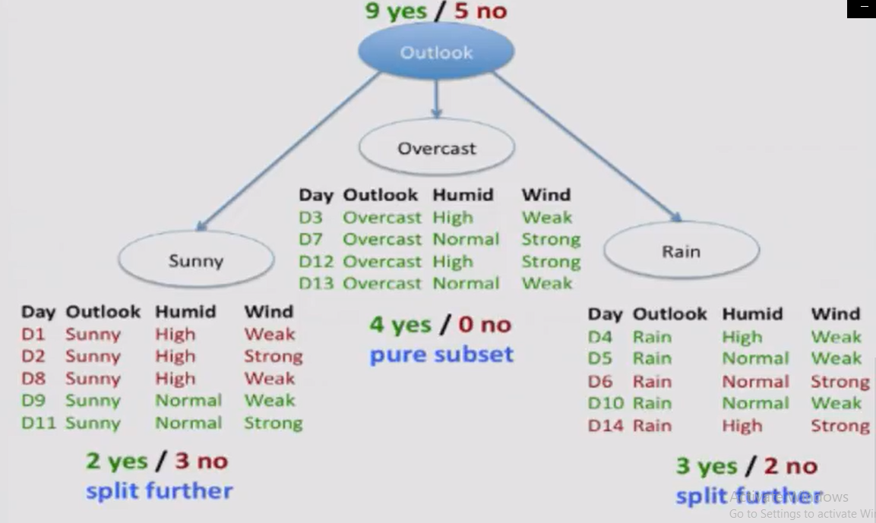

Slide 47
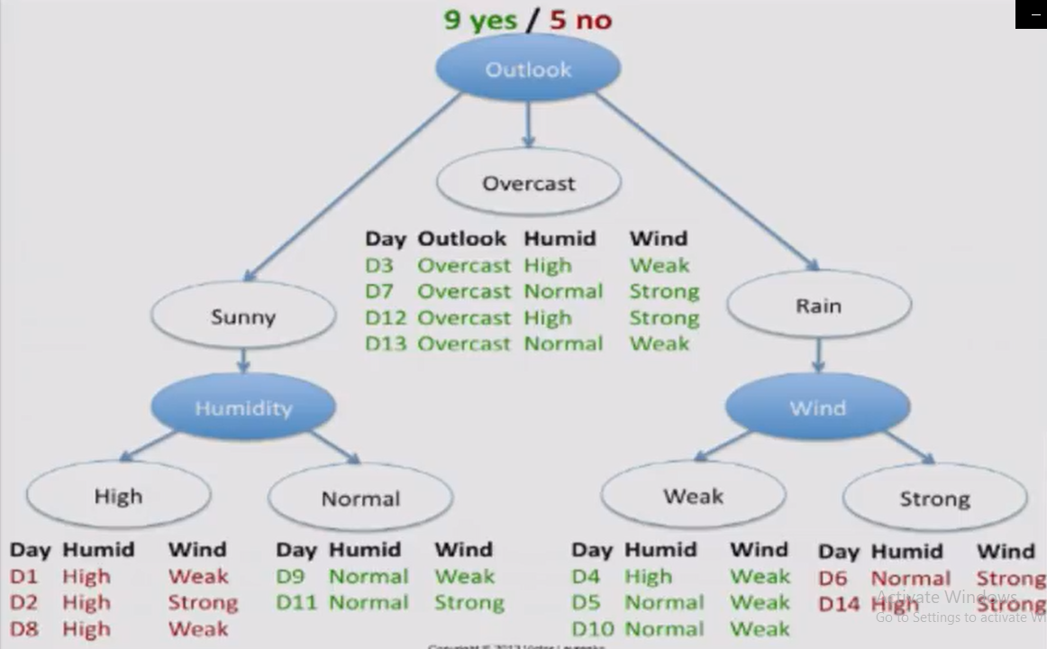

Slide 48
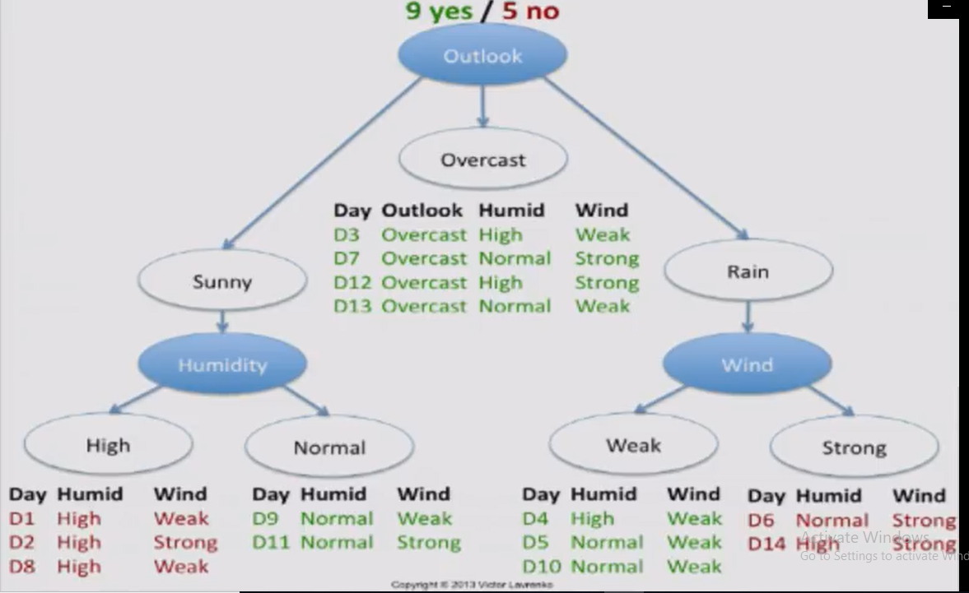

Slide 49
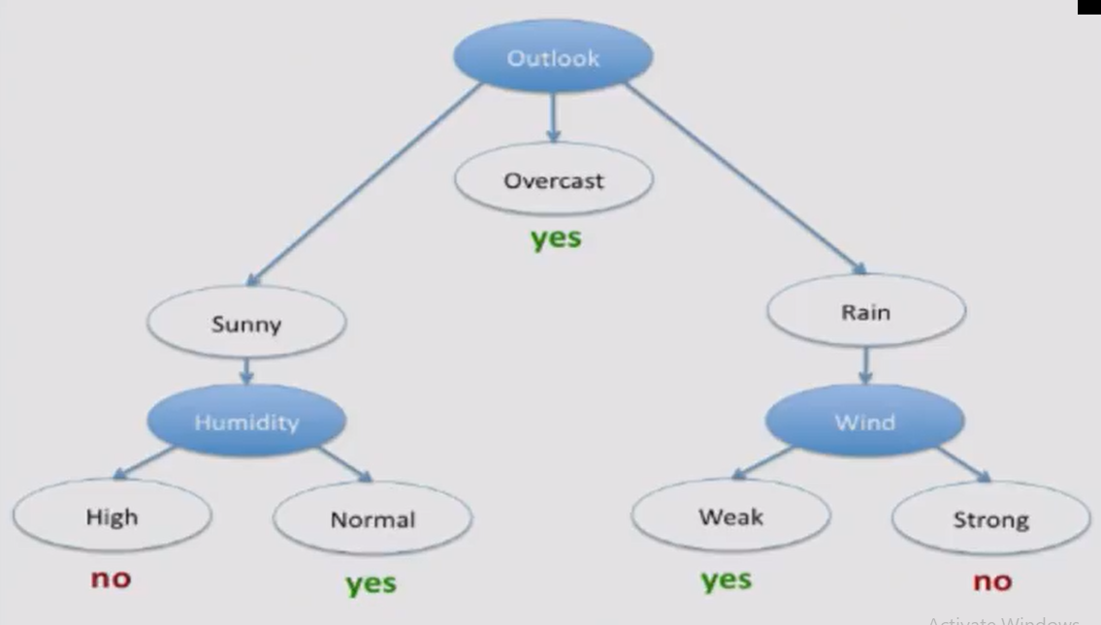

Slide 50
ID3 Algorithm
One of the most common decision tree algorithm
It perform division of attributes into two groups.
Those attributes which are most dominant attribute and other attributes to construct tree
It calculate the entropy and Information Gains of each attribute to identify the most dominant attribute.
In last the most dominant attribute is kept on decision node

Slide 51
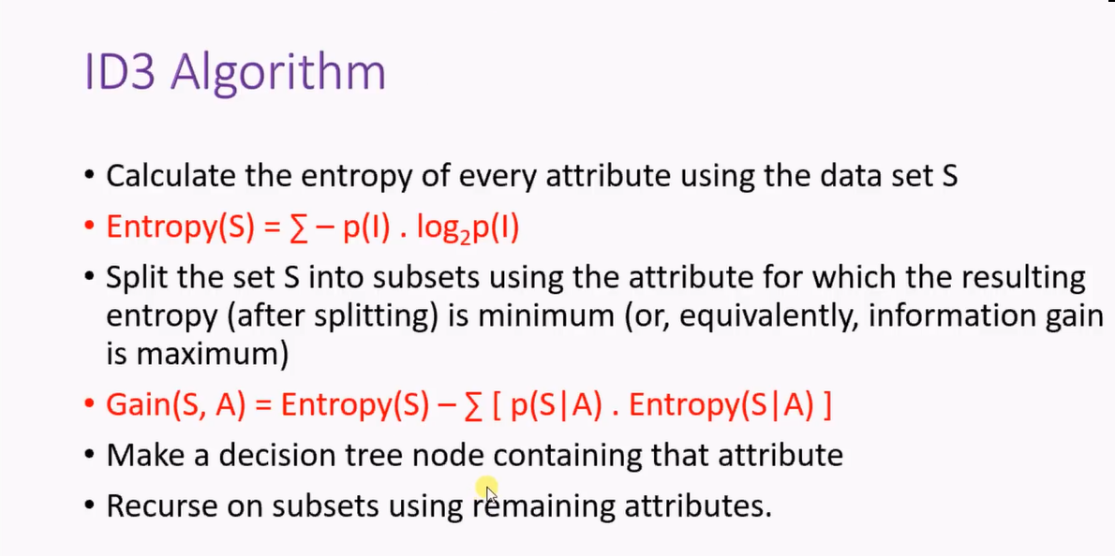

Slide 52
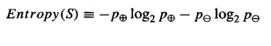
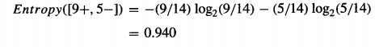
Entropy
Is a measure of the randomness in the information being processed.
It characterize the purity of collection of example

Slide 53
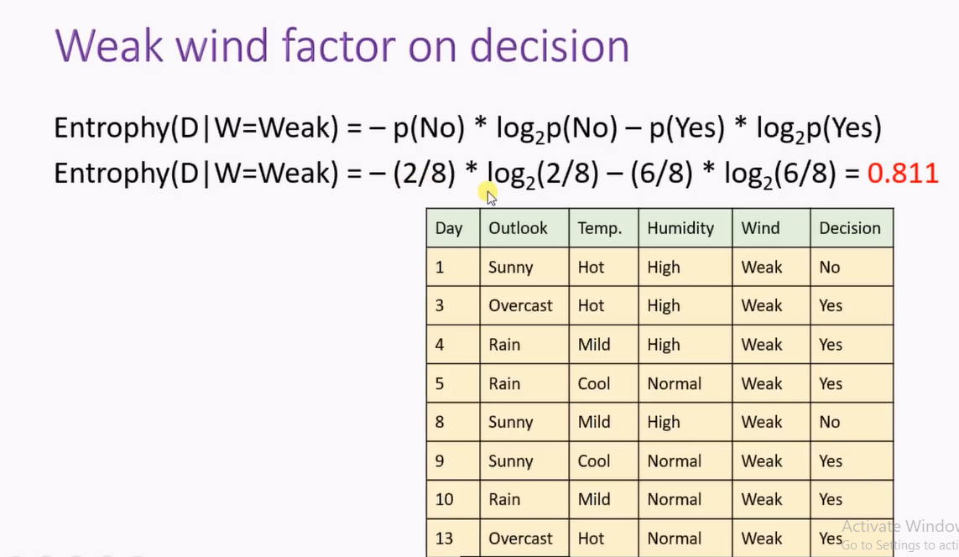

Slide 54
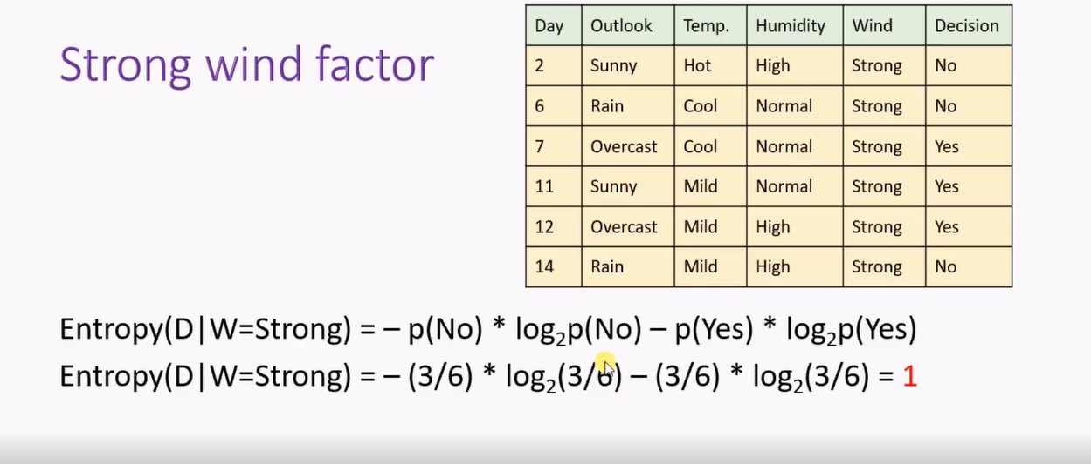

Slide 55
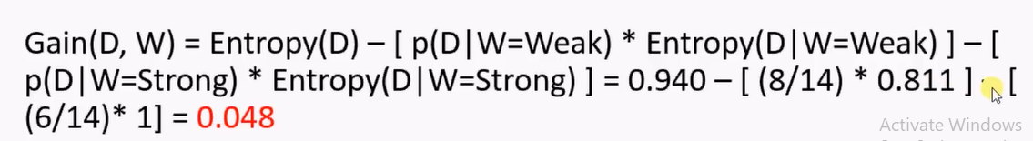
Information Gain
It measure of the effectiveness of an attribute in classifying the training data

Slide 56
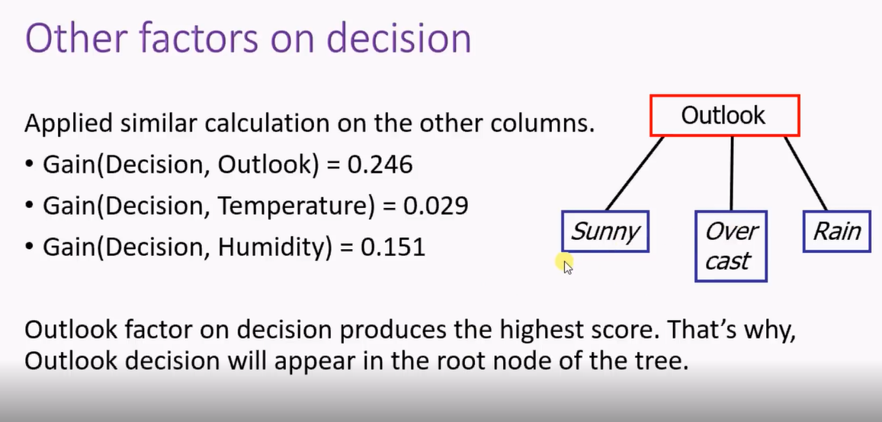

Slide 57
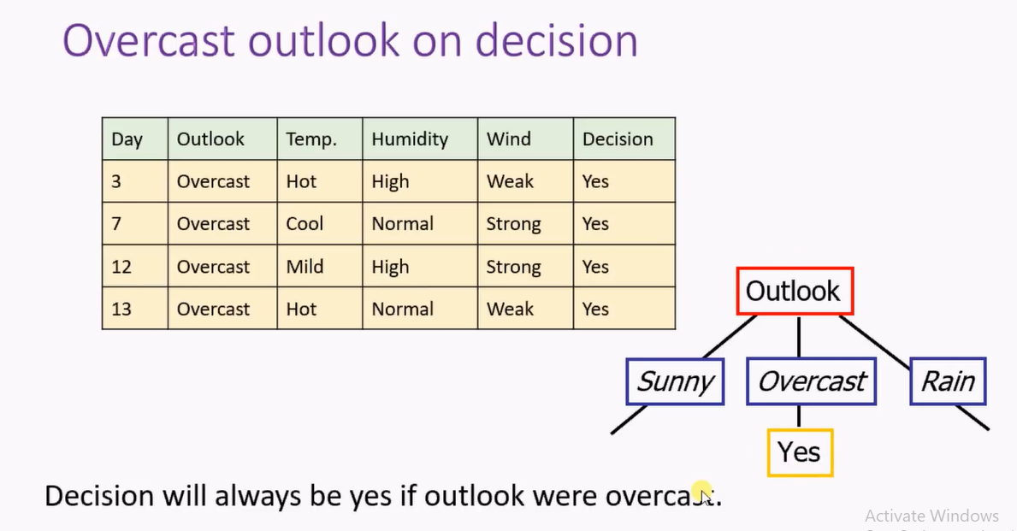

Slide 58
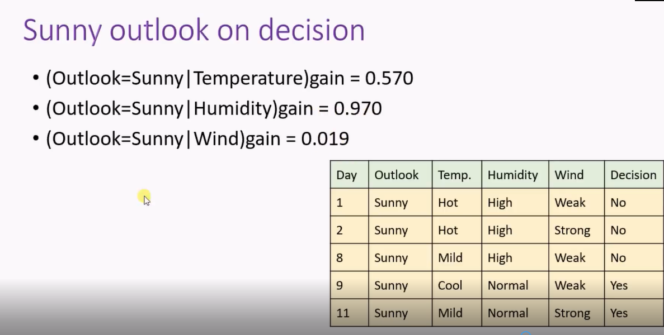

Slide 59
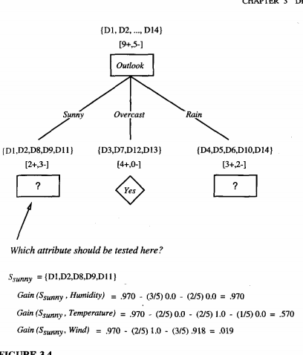

Slide 60
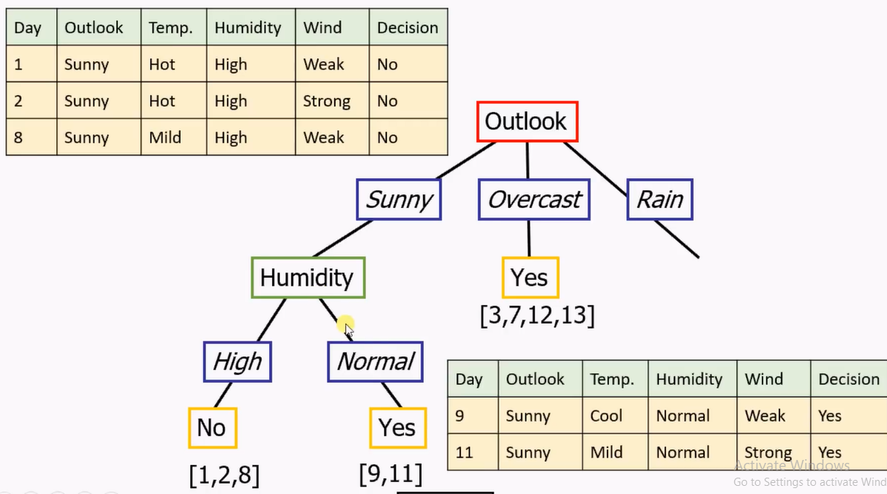

Slide 61
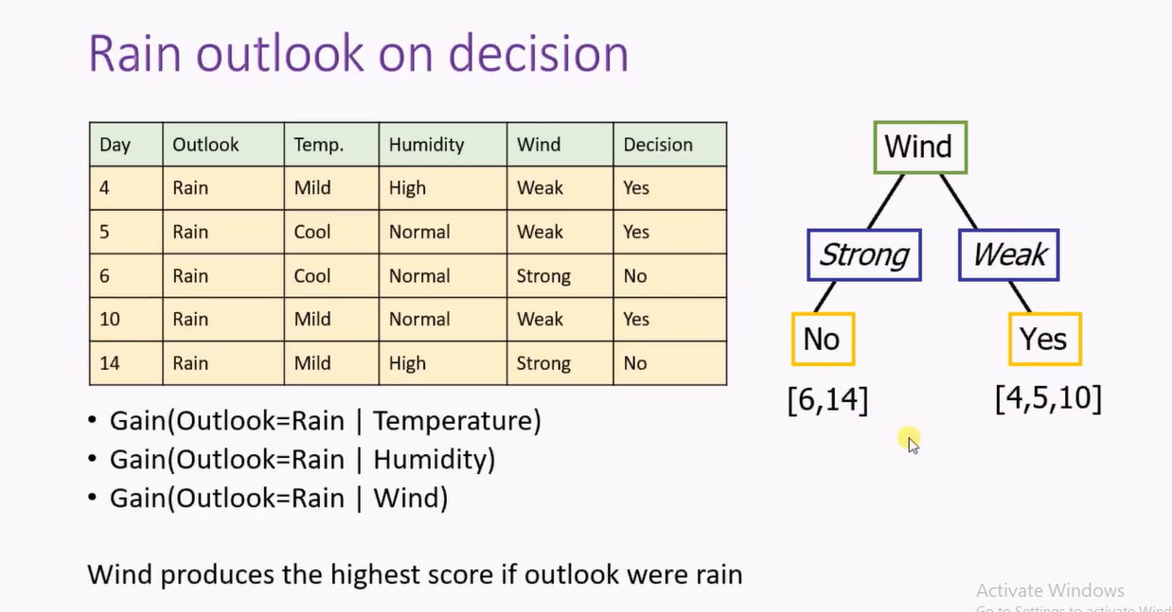

Slide 62
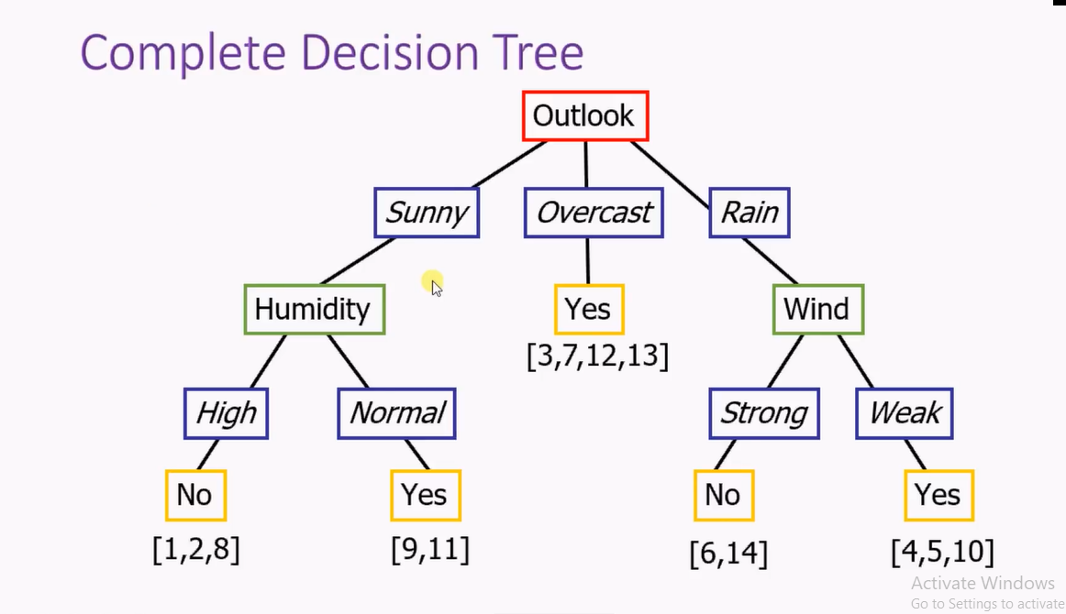

Slide 63
Naive Bayes classifier
In machine learning, naive Bayes classifiers are a family of simple "probabilistic classifiers" based on applying Bayes' theorem with strong (naive) independence assumptions between the features.
Naive Bayes classifiers are highly scalable, requiring a number of parameters linear in the number of variables (features/predictors) in a learning problem.

Slide 64
Naive Bayes classifier
In the statistics and computer science literature, naive Bayes models are known under a variety of names, including simple Bayes and independence Bayes
There is not a single algorithm for training such classifiers, but a family of algorithms based on a common principle: all naive Bayes classifiers assume that the value of a particular feature is independent of the value of any other feature, given the class variable.
For example, a fruit may be considered to be an apple if it is red, round, and about 10 cm in diameter. A naive Bayes classifier considers each of these features to contribute independently to the probability that this fruit is an apple, regardless of any possible correlations between the color, roundness, and diameter features.

Slide 65
Naive Bayes classifier
Bayes Theorem named after Rev. Thomas Bayes. It works on conditional probability. Conditional probability is the probability that something will happen, given that something else has already occurred. Using the conditional probability, we can calculate the probability of an event using its prior knowledge.
P(A|B)= Probability of A when B is true
Naïve Bayes uses conditional probability for classification
P(A|B)= P(B|A)*P(A)/P(B)

Slide 66
Example
Fruit | Yellow | Sweet | Long | Total
Mango | 350 | 450 | 0 | 650
Banana | 400 | 300 | 350 | 400
Others | 50 | 100 | 50 | 150
Total | 800 | 850 | 400 | 1200
X=<yellow, sweet, long>=?

Slide 67
Bayesian Belief network
Bayesian Belief network or probabilistic directed acyclic graphical model is a probabilistic graphical model (a type of statistical model) that represents a set of variables and their conditional dependencies via a directed acyclic graph (DAG).
Bayesian networks are ideal for taking an event that occurred and predicting the likelihood that any one of several possible known causes was the contributing factor.
For example, a Bayesian network could represent the probabilistic relationships between diseases and symptoms

Slide 68
Directed Acyclic Graph (DAG)
Directed: The connections/edges denote cause->effect relationships between pairs of nodes. For example Burglary->Alarm in the above network indicates that the occurrence of a burglary directly affects the probability of the Alarm going off (and not the other way round). Here, Burglary is the parent, while Alarm is the child node.

Slide 69
DAG cont….
Acyclic: There cannot be a cycle in a BBN. In simple English, a variable cannot depend on its own value – directly, or indirectly. If this was allowed, it would lead to a sort of infinite recursion which we are not prepared to deal with. However, if you do realize that an event happening affects its probability later on, then you could express the two occurrences as separate nodes in the BBN
One of the biggest considerations while building a BBN is to decide which parents to assign to a particular node. Intuitively, they should be those variables which most directly affect the value of the current node.

Slide 70
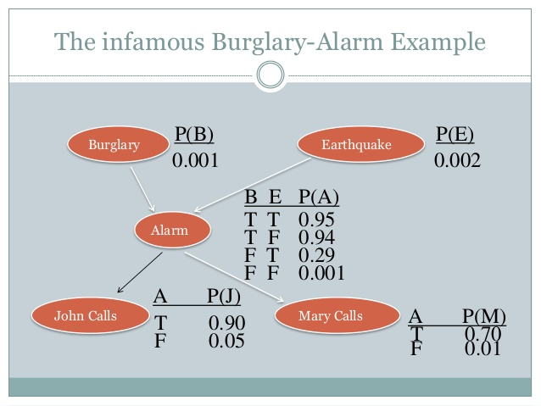

Slide 71
DAG cont…
Nodes = random variables Burglary, Earthquake, Alarm, Mary calls and John calls • Links = direct (causal) dependencies between variables. The chance of Alarm being is influenced by Earthquake, The chance of John calling is affected by the Alarm

Slide 72
Artificial Neural Network (ANN)
Neural networks are parallel computing devices, which are basically an attempt to make a computer model of the brain. The main objective is to develop a system to perform various computational tasks faster than the traditional systems.
Artificial Neural Network (ANN) is an efficient computing system whose central theme is borrowed from the analogy of biological neural networks. ANNs are also named as “artificial neural systems,” or “parallel distributed processing systems,” or “connectionist systems.” ANN acquires a large collection of units that are interconnected in some pattern to allow communication between the units.
These units, also referred to as nodes or neurons, are simple processors which operate in parallel.

Slide 73
ANN cont….
Every neuron is connected with other neuron through a connection link. Each connection link is associated with a weight that has information about the input signal.
This is the most useful information for neurons to solve a particular problem because the weight usually excites or inhibits the signal that is being communicated.
Each neuron has an internal state, which is called an activation signal. Output signals, which are produced after combining the input signals and activation rule, may be sent to other units

Slide 74
A Brief History of ANN
1940s to 1960s
1943 − It has been assumed that the concept of neural network started with the work of physiologist, Warren McCulloch, and mathematician, Walter Pitts, when in 1943 they modeled a simple neural network using electrical circuits in order to describe how neurons in the brain might work.
1949 − Donald Hebb’s book, The Organization of Behavior, put forth the fact that repeated activation of one neuron by another increases its strength each time they are used.
1956 − An associative memory network was introduced by Taylor.
1958 − A learning method for McCulloch and Pitts neuron model named Perceptron was invented by Rosenblatt.
1960 − Bernard Widrow and Marcian Hoff developed models called "ADALINE" and “MADALINE.”

Slide 75
1960-1980
1961 − Rosenblatt made an unsuccessful attempt but proposed the “backpropagation” scheme for multilayer networks.
1964 − Taylor constructed a winner-take-all circuit with inhibitions among output units.
1969 − Multilayer perceptron (MLP) was invented by Minsky and Papert.
1971 − Kohonen developed Associative memories.
1976 − Stephen Grossberg and Gail Carpenter developed Adaptive resonance theory.

Slide 76
1980-Present
1982 − The major development was Hopfield’s Energy approach.
1985 − Boltzmann machine was developed by Ackley, Hinton, and Sejnowski.
1986 − Rumelhart, Hinton, and Williams introduced Generalised Delta Rule.
1988 − Kosko developed Binary Associative Memory (BAM) and also gave the concept of Fuzzy Logic in ANN.

Slide 77
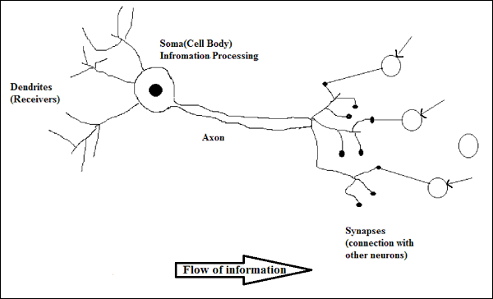
Biological Neuron
A nerve cell (neuron) is a special biological cell that processes information. According to an estimation, there are huge number of neurons, approximately 10¹¹ with numerous interconnections, approximately 10¹⁵

Slide 78
Working of a Biological Neuron
As shown in the above diagram, a typical neuron consists of the following four parts with the help of which we can explain its working −
Dendrites − They are tree-like branches, responsible for receiving the information from other neurons it is connected to. In other sense, we can say that they are like the ears of neuron.
Soma − It is the cell body of the neuron and is responsible for processing of information, they have received from dendrites.
Axon − It is just like a cable through which neurons send the information.
Synapses − It is the connection between the axon and other neuron dendrites.

Slide 79
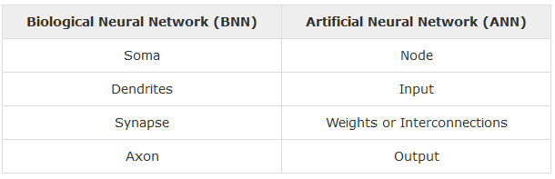
ANN versus BNN
Before taking a look at the differences between Artificial Neural Network (ANN) and Biological Neural Network (BNN), let us take a look at the similarities based on the terminology between these two.

Slide 80
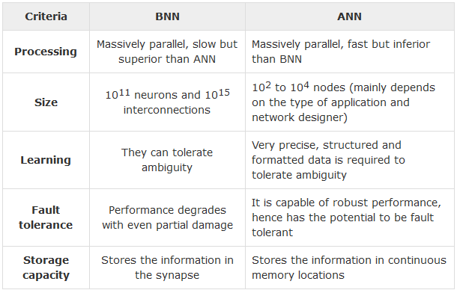
Comparison

Slide 81
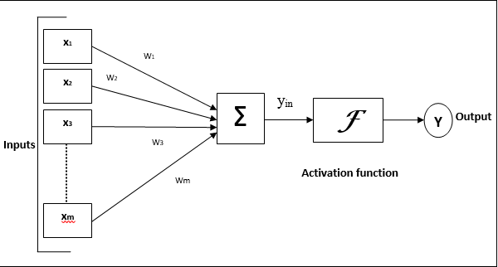
Model of Artificial Neural Network

Slide 82
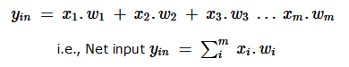
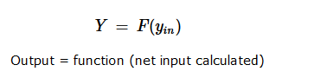

Slide 83
Network Topology
A network topology is the arrangement of a network along with its nodes and connecting lines. According to the topology, ANN can be classified as the following kinds
Feedforward Network
It is a non-recurrent network having processing units/nodes in layers and all the nodes in a layer are connected with the nodes of the previous layers. The connection has different weights upon them. There is no feedback loop means the signal can only flow in one direction, from input to output. It may be divided into the following two types

Slide 84
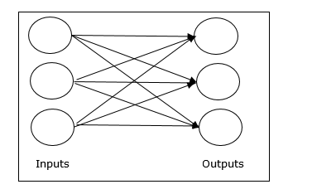
Single layer feedforward network
The concept is of feed forward ANN having only one weighted layer. In other words, we can say the input layer is fully connected to the output layer.

Slide 85
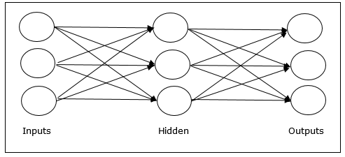
Multilayer feedforward network
The concept is of feedforward ANN having more than one weighted layer. As this network has one or more layers between the input and the output layer, it is called hidden layers

Slide 86
Feedback Network
As the name suggests, a feedback network has feedback paths, which means the signal can flow in both directions using loops. This makes it a non-linear dynamic system, which changes continuously until it reaches a state of equilibrium. It may be divided into the following types
Recurrent networks − They are feedback networks with closed loops. Following are the two types of recurrent networks.
Fully recurrent network − It is the simplest neural network architecture because all nodes are connected to all other nodes and each node works as both input and output.

Slide 87
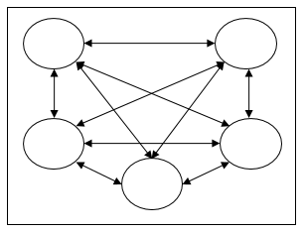
Feedback network

Slide 88
Why We Need Artificial Neural Network
We need to understand the answer to the above question with an example of a human being. As a child, we used to learn the things with the help of our elders, which includes our parents or teachers. Then later by self-learning or practice we keep learning throughout our life. Scientists and researchers are also making the machine intelligent, just like a human being, and ANN plays a very important role in the same due to the following reasons

Slide 89
With the help of neural networks, we can find the solution of such problems for which algorithmic method is expensive or does not exist.
Neural networks can learn by example, hence we do not need to program it at much extent.
Neural networks have the accuracy and significantly fast speed than conventional speed.

Slide 90
Hebb Neural Network
Hebbian learning is one of the oldest learning algorithms, and is based in large part on the dynamics of biological systems.
A synapse between two neurons is strengthened when the neurons on either side of the synapse (input and output) have highly correlated outputs.
In essence, when an input neuron fires, if it frequently leads to the firing of the output neuron, the synapse is strengthened. Following the analogy to an artificial system, the weight is increased with high correlation between two sequential neurons.

Slide 91
The Hebbian learning algorithm is performed locally, and doesn’t take into account the overall system input-output characteristic.
This makes it a plausible theory for biological learning methods, and also makes Hebbian learning processes ideal in VLSI hardware implementations where local signals are easier to obtain.

Slide 92
Algorithm
Step I:
Initialize all the weights & Bias to Zero
Wi=0 for i=1 to n
Step II:
For each input training vector (I/P)and target vector (O/P) pair (S,t)
Perform step III to step VI.
Step III:
Set activation for input unit with Input vector
Xi=Si (i=1 to n)

Slide 93
Algo….
Step IV:
Set activation function for output with output neuron
Y=t
Step V:
Adjust the weights by applying Hebb Rule
Wi (new)=xi (old)+xiy for i=1 to n
Step VI:
Adjust the bias
B(new)= B(old)

Slide 94
Example
X1 | X2 | B
1 | -1 | 1
1 | 1 | 1
-1 | -1 | 1
1 | 1 | 1
Notes:
Example is solved on board and notes will be provided

Slide 95
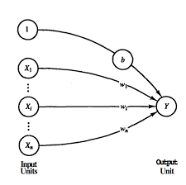
HebbNet

Slide 96
Perceptron
Perceptron is the basic operational unit of artificial neural networks. It employs supervised learning rule and is able to classify the data into two classes.
Operational characteristics of the perceptron: It consists of a single neuron with an arbitrary number of inputs along with adjustable weights, but the output of the neuron is 1 or 0 depending upon the threshold. It also consists of a bias whose weight is always 1. Following figure gives a schematic representation of the perceptron.

Slide 97
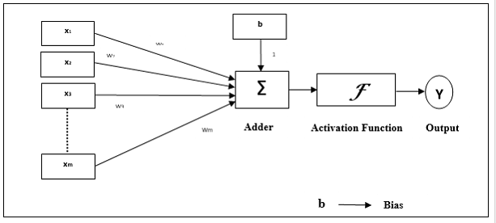
Perceptron Network

Slide 98
Elements of Perceptron
Perceptron has the following three basic elements −
Links − It would have a set of connection links, which carries a weight including a bias always having weight 1.
Adder − It adds the input after they are multiplied with their respective weights.
Activation function − It limits the output of neuron. The most basic activation function is a Heaviside step function that has two possible outputs. This function returns 1, if the input is positive, and 0 for any negative input.

Slide 99
Training Algorithm
Perceptron network can be trained for single output unit as well as multiple output units.
Step 1 − Initialize the following to start the training −
Weights
Bias
Learning rate α
For easy calculation and simplicity, weights and bias must be set equal to 0 and the learning rate must be set equal to 1.
Step 2 − Continue step 3-8 when the stopping condition is not true.
Step 3 − Continue step 4-6 for every training vector x.

Slide 100
Step 4 − Activate each input unit as follows −
xi=si (i=1 to n)
Step 5 − Now obtain the net input with the following relation −
yin=b+∑xi.wi
Here ‘b’ is bias and ‘n’ is the total number of input neurons.

Slide 101
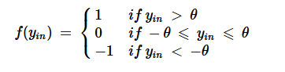
Step 6 − Apply the following activation function to obtain the final output.

Slide 102
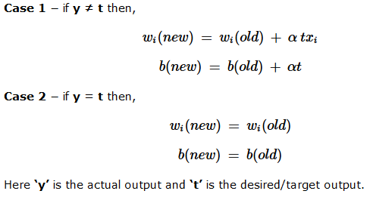
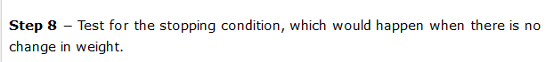
Step 7 − Adjust the weight and bias as follows −

Slide 103
Multi-Layer Perceptron
A multilayer perceptron (MLP) is a class of feedforward artificial neural network.
A MLP consists of at least three layers of nodes: an input layer, a hidden layer and an output layer. Except for the input nodes, each node is a neuron that uses a nonlinear activation function.

Slide 104
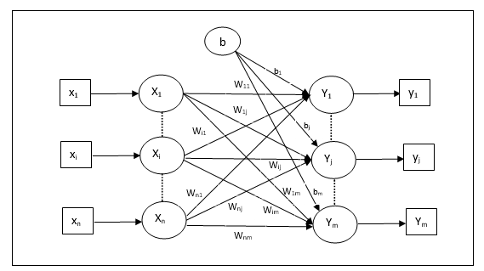
MLP Network

Slide 105
Multilayer perceptrons are often applied to supervised learning problems: they train on a set of input-output pairs and learn to model the correlation (or dependencies) between those inputs and outputs.
Training involves adjusting the parameters, or the weights and biases, of the model in order to minimize error.
Backpropagation is used to make those weigh and bias adjustments relative to the error, and the error itself can be measured in a variety of ways, including by root mean squared error (RMSE).

Slide 106
Algorithm
Step 1 − Initialize the following to start the training −
Weights
Bias
Learning rate α
For easy calculation and simplicity, weights and bias must be set equal to 0 and the learning rate must be set equal to 1.
Step 2 − Continue step 3-8 when the stopping condition is not true.
Step 3 − Continue step 4-6 for every training vector x.

Slide 107
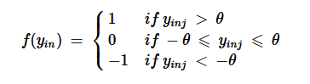
Step 4 − Activate each input unit as follows −
xi= si(i=1ton)
Step 5 − Obtain the net input with the following relation −
yin=b+∑xi.wij
Step 6 − Apply the following activation function to obtain the final output for each output unit j = 1 to m −

Slide 108
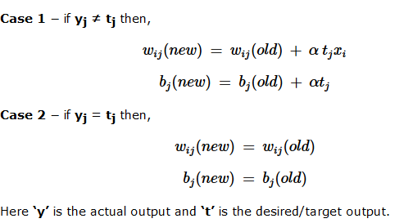
Step 7 − Adjust the weight and bias for x = 1 to n and j = 1 to m as follows

Slide 109
Applications
MLPs are useful in research for their ability to solve problems stochastically, which often allows approximate solutions for extremely complex problems.
MLPs are universal function approximators as they can be used to create mathematical models by regression analysis.
As classification is a particular case of regression when the response variable is categorical, MLPs make good classifier algorithms.
MLPs were a popular machine learning solution in the 1980s, finding applications in diverse fields such as speech recognition, image recognition, and machine translation software, but thereafter faced strong competition from much simpler (and related) support vector machines. Interest in backpropagation networks returned due to the successes of deep learning.

Slide 110
Adaptive Linear Neuron (Adaline)
Adaline which stands for Adaptive Linear Neuron, is a network having a single linear unit. It was developed by Widrow and Hoff in 1960. Some important points about Adaline are as follows :
It uses activation function.
It uses delta rule for training to minimize the Mean-Squared Error (MSE) between the actual output and the desired/target output.
The weights and the bias are adjustable.

Slide 111
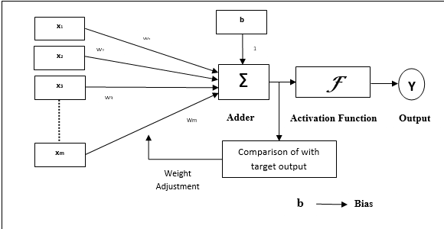
Architecture
The basic structure of Adaline is similar to perceptron having an extra feedback loop with the help of which the actual output is compared with the desired/target output. After comparison on the basis of training algorithm, the weights and bias will be updated.

Slide 112
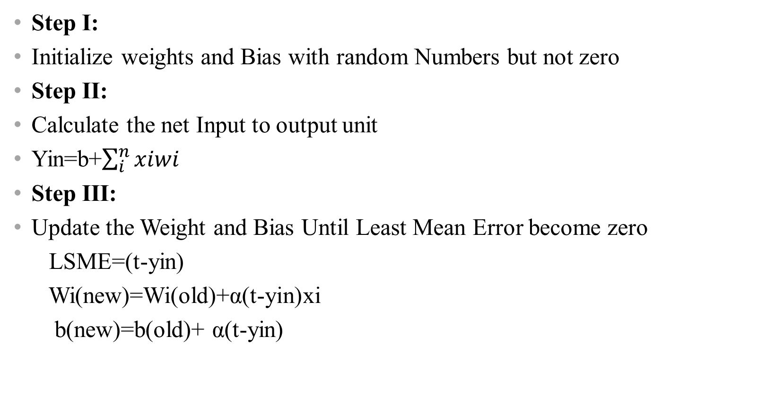
Algorithm
Step I:
Initialize weights and Bias with random Numbers but not zero
Step II:
Calculate the net Input to output unit
Yin=b+$\sum_{i}^{n}{xiwi}$
Step III:
Update the Weight and Bias Until Least Mean Error become zero
LSME=(t-yin)
Wi(new)=Wi(old)+α(t-yin)xi
b(new)=b(old)+ α(t-yin)

Slide 113
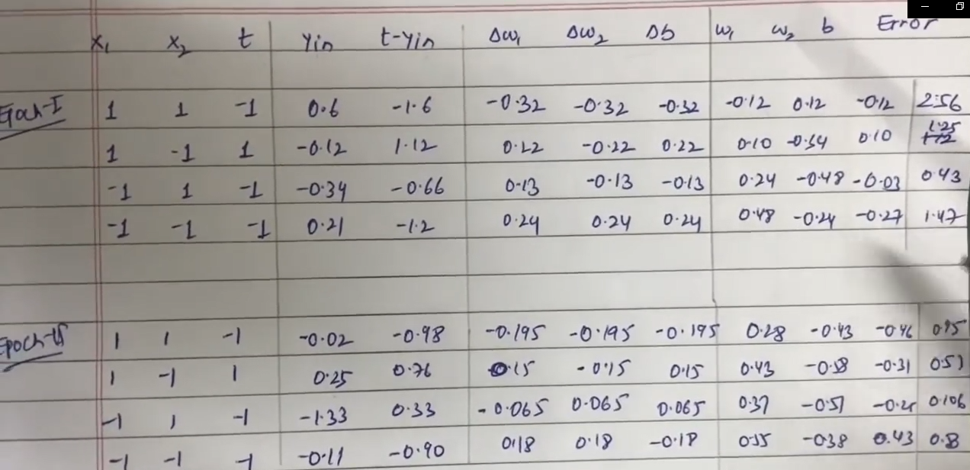

Slide 114
Multiple Adaptive Linear Neuron (Madaline)
Madaline which stands for Multiple Adaptive Linear Neuron, is a network which consists of many Adalines in parallel. It will have a single output unit. Some important points about Madaline are as follows −
It is just like a multilayer perceptron, where Adaline will act as a hidden unit between the input and the Madaline layer.
The weights and the bias between the input and Adaline layers, as in we see in the Adaline architecture, are adjustable.
The Adaline and Madaline layers have fixed weights and bias of 1

Slide 115

Architecture

Slide 116
Architecture
The architecture of Madaline consists of “n” neurons of the input layer, “m” neurons of the Adaline layer, and 1 neuron of the Madaline layer. The Adaline layer can be considered as the hidden layer as it is between the input layer and the output layer, i.e. the Madaline layer.

Slide 117
Back Propagation Neural Networks
Back Propagation Neural (BPN) is a multilayer neural network consisting of the input layer, at least one hidden layer and output layer. As its name suggests, back propagating will take place in this network. The error which is calculated at the output layer, by comparing the target output and the actual output, will be propagated back towards the input layer

Slide 118
Architecture
As shown in the diagram, the architecture of BPN has three interconnected layers having weights on them. The hidden layer as well as the output layer also has bias, whose weight is always 1, on them. As is clear from the diagram, the working of BPN is in two phases. One phase sends the signal from the input layer to the output layer, and the other phase back propagates the error from the output layer to the input layer.

Slide 119
Training
For training, BPN will use binary sigmoid activation function. The training of BPN will have the following three phases.
Phase 1 − Feed Forward Phase
Phase 2 − Back Propagation of error
Phase 3 − Updating of weights

Slide 120
Algo…..
Step 1 − Initialize the following to start the training −
Weights
Learning rate α
For easy calculation and simplicity, take some small random values.
Step 2 − Continue step 3-11 when the stopping condition is not true.
Step 3 − Continue step 4-10 for every training pair.

Slide 121

Phase I

Slide 122

Phase I…

Slide 123

Phase II

Slide 124

Phase II…

Slide 125

Phase III

Slide 126
Unsupervised Learning Algorithms
In machine learning, unsupervised learning is a class of problems in which one seeks to determine how the data are organized. It is distinguished from supervised learning (and reinforcement learning) in that the learner is given only unlabeled examples.
Clustering Clustering is the assignment of a set of observations into subsets (called clusters) so that observations in the same cluster are similar in some sense. Clustering is a method of unsupervised learning, and a common technique for statistical data analysis used in many fields.

Slide 127
Example
Let’s understand this with an example. Suppose, you are the head of a rental store and wish to understand preferences of your costumers to scale up your business. Is it possible for you to look at details of each costumer and devise a unique business strategy for each one of them? Definitely not. But, what you can do is to cluster all of your costumers into say 10 groups based on their purchasing habits and use a separate strategy for costumers in each of these 10 groups. And this is what we call clustering.
Now, that we understand what is clustering. Let’s take a look at the types of clustering.

Slide 128
Types of Clustering
Broadly speaking, clustering can be divided into two subgroups :
Hard Clustering: In hard clustering, each data point either belongs to a cluster completely or not. For example, in the above example each customer is put into one group out of the 10 groups.
Soft Clustering: In soft clustering, instead of putting each data point into a separate cluster, a probability or likelihood of that data point to be in those clusters is assigned. For example, from the above scenario each costumer is assigned a probability to be in either of 10 clusters of the retail store.

Slide 129
Types of clustering algorithms
Since the task of clustering is subjective, the means that can be used for achieving this goal are plenty. Every methodology follows a different set of rules for defining the ‘similarity’ among data points. In fact, there are more than 100 clustering algorithms known. But few of the algorithms are used popularly, let’s look at them in detail:

Slide 130
Connectivity models:
As the name suggests, these models are based on the notion that the data points closer in data space exhibit more similarity to each other than the data points lying farther away.
These models can follow two approaches. In the first approach, they start with classifying all data points into separate clusters & then aggregating them as the distance decreases.
In the second approach, all data points are classified as a single cluster and then partitioned as the distance increases. Also, the choice of distance function is subjective.
These models are very easy to interpret but lacks scalability for handling big datasets. Examples of these models are hierarchical clustering algorithm and its variants.

Slide 131
Centroid models
These are iterative clustering algorithms in which the notion of similarity is derived by the closeness of a data point to the centroid of the clusters. K-Means clustering algorithm is a popular algorithm that falls into this category.
In these models, the no. of clusters required at the end have to be mentioned beforehand, which makes it important to have prior knowledge of the dataset. These models run iteratively to find the local optima.

Slide 132
Distribution models:
These clustering models are based on the notion of how probable is it that all data points in the cluster belong to the same distribution (For example: Normal, Gaussian).
These models often suffer from overfitting. A popular example of these models is Expectation-maximization algorithm which uses multivariate normal distributions.

Slide 133
Density Models
These models search the data space for areas of varied density of data points in the data space.
It isolates various different density regions and assign the data points within these regions in the same cluster.
Popular examples of density models are DBSCAN and OPTICS.

Slide 134
K-means Clustering
K-means clustering is an algorithm to classify or to group your objects based on attributes/features into K number of group. K is positive integer number.
The grouping is done by minimizing the sum of squares of distances between data and the corresponding cluster centroid. Thus the purpose of K-mean clustering is to classify the data.
The basic step of k-means clustering is simple. In the beginning we determine number of cluster K and we assume the centroid or center of these clusters. We can take any random objects as the initial centroids or the first K objects in sequence can also serve as the initial centroids.

Slide 135
Algorithm
Step 1. Begin with a decision on the value of k = number of clusters.
Step 2. Put any initial partition that classifies the data into k clusters. You may assign the training samples randomly, or
systematically as the following:
1) Take the first k training sample as single-element clusters.
2) Assign each of the remaining (N-k) training sample to the cluster with the nearest centroid. After each assignment, recomputed the centroid of
the gaining cluster.

Slide 136
Algo……
Step 3 . Take each sample in sequence and compute its distance from the centroid of each of the clusters. If a sample is not currently in the cluster with the closest centroid, switch this sample to that cluster and update the centroid of the cluster gaining the new sample and the cluster losing the sample.
Step 4 . Repeat step 3 until convergence is achieved, that is until a pass through the training sample causes no new assignments.

Slide 137

Flow Chart

Slide 138

Example

Slide 139

K-Nearest Neighbors Algorithm
The k-nearest neighbors (KNN) algorithm is a simple, easy-to-implement supervised machine learning algorithm that can be used to solve both classification and regression problems.
A classification problem has a discrete value as its output. For example, “likes pineapple on pizza” and “does not like pineapple on pizza” are discrete. There is no middle ground. The analogy above of teaching a child to identify a pig is another example of a classification problem.

Slide 140

A regression problem has a real number (a number with a decimal point) as its output. For example, we could use the data in the table below to estimate someone’s weight given their height.

Slide 141


Slide 142
Notice in the image above that most of the time, similar data points are close to each other. The KNN algorithm hinges on this assumption being true enough for the algorithm to be useful. KNN captures the idea of similarity (sometimes called distance, proximity, or closeness) with some mathematics we might have learned in our childhood— calculating the distance between points on a graph

Slide 143
Algorithm
The KNN Algorithm
Load the data
Initialize K to your chosen number of neighbors
3. For each example in the data
3.1 Calculate the distance between the query example and the current example from the data.
3.2 Add the distance and the index of the example to an ordered collection

Slide 144
4. Sort the ordered collection of distances and indices from smallest to largest (in ascending order) by the distances
5. Pick the first K entries from the sorted collection
6. Get the labels of the selected K entries
7. If regression, return the mean of the K labels
8. If classification, return the mode of the K labels

Slide 145
Choosing the right value for K
To select the K that’s right for your data, we run the KNN algorithm several times with different values of K and choose the K that reduces the number of errors we encounter while maintaining the algorithm’s ability to accurately make predictions when it’s given data it hasn’t seen before.
Here are some things to keep in mind:
1. As we decrease the value of K to 1, our predictions become less stable. Just think for a minute, image K=1 and we have a query point surrounded by several reds and one green (I’m thinking about the top left corner of the colored plot above), but the green is the single nearest neighbor. Reasonably, we would think the query point is most likely red, but because K=1, KNN incorrectly predicts that the query point is green.

Slide 146
2 Inversely, as we increase the value of K, our predictions become more stable due to majority voting / averaging, and thus, more likely to make more accurate predictions (up to a certain point). Eventually, we begin to witness an increasing number of errors. It is at this point we know we have pushed the value of K too far.
In cases where we are taking a majority vote (e.g. picking the mode in a classification problem) among labels, we usually make K an odd number to have a tiebreaker.

Slide 147
Advantages
The algorithm is simple and easy to implement.
There’s no need to build a model, tune several parameters, or make additional assumptions.
The algorithm is versatile. It can be used for classification, regression, and search (as we will see in the next section).
Disadvantages
The algorithm gets significantly slower as the number of examples and/or predictors/independent variables increase.

Slide 148
What is Deep Learning
Deep learning is an artificial intelligence function that imitates the workings of the human brain in processing data and creating patterns for use in decision making.
Deep learning is a subset of machine learning in artificial intelligence (AI) that has networks capable of learning unsupervised from data that is unstructured or unlabeled. Also known as deep neural learning or deep neural network.

Slide 149
Deep learning is a machine learning technique that teaches computers to do what comes naturally to humans: learn by example.
Deep learning is a key technology behind driverless cars, enabling them to recognize a stop sign, or to distinguish a pedestrian from a lamppost. It is the key to voice control in consumer devices like phones, tablets, TVs, and hands-free speakers.
Deep learning is getting lots of attention lately and for good reason. It’s achieving results that were not possible before.

Slide 150
In deep learning, a computer model learns to perform classification tasks directly from images, text, or sound. Deep learning models can achieve state-of-the-art accuracy, sometimes exceeding human-level performance. Models are trained by using a large set of labeled data and neural network architectures that contain many layers.

Slide 151
Types of Deep Learning
Like machine learning, deep learning approaches can be categorized as follows: supervised, semi-supervised or partially supervised, and unsupervised. In addition, there is another category of learning called Reinforcement Learning.

Slide 152
Deep learning requires large amounts of labeled data. For example, driverless car development requires millions of images and thousands of hours of video.
Deep learning requires substantial computing power. High-performance GPUs have a parallel architecture that is efficient for deep learning. When combined with clusters or cloud computing, this enables development teams to reduce training time for a deep learning network from weeks to hours or less.

Slide 153
The term “deep” usually refers to the number of hidden layers in the neural network. Traditional neural networks only contain 2-3 hidden layers, while deep networks can have as many as 150.
Deep learning models are trained by using large sets of labeled data and neural network architectures that learn features directly from the data without the need for manual feature extraction.

Slide 154
CNN (Convolutional Neural Networks)
This network structure was first proposed by Fukushima in 1988
It was not widely used however due to limits of computation hardware for training the network.
CNNs have several advantages over DNNs, including being more similar to the human visual processing system, being highly optimized in structure for processing 2D and 3D images, and being effective at learning and extracting abstractions of 2D features.

Slide 155

Feature Extraction Through CNN

Slide 156
Architecture
Fig. shows the overall architecture of CNNs consist of two
main parts:
1)In the feature extraction layers, each layer of the network receives the output from its immediate previous layer as its input, and passes its
output as the input to the next layer.
The CNN architecture
consists of a combination of three types of layers: convolution, max-pooling, and classification

Slide 157
Convolutional Layer
A filter is used to detect the presence of specific features or patterns present in the original image (input). It is usually expressed as a matrix (MxMx3), with a smaller dimension but the same depth as the input file.
A pooling layer is another building block of a CNN. Its function is to progressively reduce the spatial size of the representation to reduce the amount of parameters and computation in the network. Pooling layer operates on each feature map independently. The most common approach used in pooling is max pooling

Slide 158

MaxPooling

Slide 159


Slide 160


Slide 161
The classifier is usually a softmax activation function. Fully connected means every neuron in the previous layer connects to every neuron in the next layer. What's the purpose of this layer? To use the features from the output of the previous layer to classify the input image based on the training data.
This is the fully connected layer which computes the score of each class from the extracted features from a convolutional layer in the preceding steps. The final layer feature maps are represented as vectors with scalar values which are passed to the fully connected layers.

